Slide 1

Welcome to Muxton Primary School
Year 5
2024/2025

Slide 2


Slide 3
Year 5 Teaching Staff
Class Teachers: Mr Powis
Miss Santopietro
Teaching Assistants: Mrs Thomas
Mrs Turner
The children will meet various other staff through their year.

Slide 4



Aims For Your Children
  For children to grow lively and enquiring minds they should find learning worthwhile and challenging.
  For children to enjoy their learning and see themselves developing new knowledge and skills
  For children to be proud of the school and community that they are part of

Slide 5

School Uniform
Key things to remember:
• No jewellery other than one pair of plain, stud earrings
• No make-up or nail varnish
• Long hair must be tied up, hair accessories must be plain and in school colours
At Muxton we believe that uniform is important and every child is expected to wear the correct uniform every day.
Our uniform is important as it:
Contributes to a sense of belonging and community
Fosters a feeling of pride
Gives a common purpose
Looks smart
Makes children feel equal to their peers in terms of appearance
All uniform items need to be labelled so that we can get them back to you if they are lost!
·

Slide 6
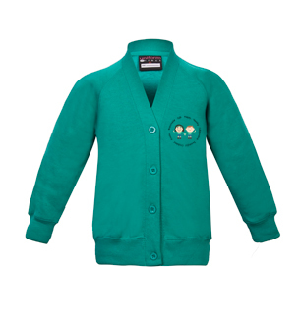
School Uniform
Year 5
• White T-shirt
• Muxton jade green cardigan or sweatshirt with school logo
• Grey or black trousers, shorts, skirt or pinafore dress (In Summer Term green check dress)
• Plain grey tights or plain grey, black or white socks
• Black shoes - no trainers or high-heels
• Book bags are available.

Slide 7

PE Days
Please wear your kit to school on PE days
PE Kit:
White T-shirt
Black shorts
Plain black tracksuit or jogging bottoms
Plain black hoodie
Trainers
All children are expected to take part in PE as it is part of the National Curriculum. We teach all children a range of skills to support them to lead healthy lives.

Slide 8
Attendance
Research has proven that there is a high correlation between school attendance and academic performance and success.
Being frequently late for school adds up to learning that is lost!
Arriving 5 minutes late every day = 3 days lost a year
Arriving 15 minutes late every day = 2 weeks lost a year
Arriving 30 minutes late every day = 19 days lost a year

Slide 9

Reading
Children will read a wide variety of fiction and non-fiction books throughout the year.
Every child needs to read a minimum of 4 times per week and record their reading in their Reading Diary. We would like two of these reads to be on Bug Club.
In class we will read a book during Guided Reading
Children will also be read to by the teacher
Please make sure children remember their reading book and reading diary each day.
Reading diaries are checked weekly

Slide 10

Writing
Children will be expected to write frequently, building their stamina as the year progresses.
Throughout the year, they will write in a variety of genres, including a range of fiction and non-fiction.
There will be a strong emphasis on vocabulary throughout the year. Children will be encouraged to use these words in their writing.
Children will continue to build upon their knowledge of grammar throughout the year.

Slide 11

Mathematics
There will be an emphasis on retrieval practice every day.
Children will revisit previously learnt concepts, as well as new learning content.
We will be using a variety of resources.
We will be carrying out fortnightly arithmetic tests.
Pupils need to practice their times tables weekly.

Slide 12


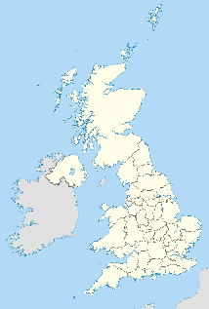




Our Wider Curriculum
At Muxton, we are committed to a broad, balanced and knowledge rich curriculum which will inspire and enthuse our children. We organise our school curriculum by mapping objectives through each stage of learning. In this way we ensure that ‘knowledge builds on knowledge’, helping children to know more and remember more.
Objectives are categorised using subject specific headings in order to outline the substantive and disciplinary knowledge that children need to know. We are of the firm belief that by identifying the key knowledge that children require, we prepare them for a progressive, ambitious curriculum and successful transition through to Secondary School.
Each area will be supported by the use of knowledge organisers.
Regular mini quizzes will be built into lessons to challenge children to recall their learning.

Slide 13
Homework
Spelling: Lists will be put in their Home School Links books and on the website every Monday. These will be tested on a Friday
Children are expected to read at home four times a week and record this in their reading diaries (these will be checked weekly). Ideally, two of these reads should be on Bug Club.
Children need to practise the named times tables each week. These will be tested on a Friday.
Homework is set on a Friday and needs to be handed in by Wednesday the following week. (Homework is also published on the website)

Slide 14
How Parents Can Help
  Ensure that your child is in school on time ready to start their day
  Encourage your child and listen to them about their school day
  Ensure they are in their correct uniform and it is labelled clearly with their name
  Provide a time and space for your child to do any homework that they might have
  Help them with learning their Spellings & Times Tables
  Ensure they are reading regularly and listen to them read. Discuss their reading with them
  Speak to the school about any issues or concerns in the first instance – we will be able to help.

Slide 15
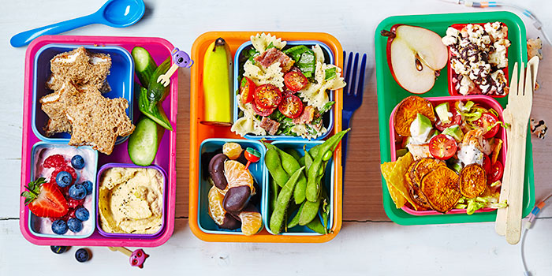

Equipment Needed
Please ensure that your child comes in with a named water bottle.
If they are a having a packed lunch please ensure their lunch box is clearly named.
Children are allowed to bring in a pencil case with basic stationary
Do not bring in anything else

Slide 16
What To Do If I Need to Speak To My Child’s Teacher?
At present the routine for speaking to your child’s class teacher will involve:
E-mailing the Year 5 Team– so that someone can get back to you.
Sending a note in with your child – so that someone can get back to you.
At the start/end of the day it will be very difficult to communicate with the teacher. We therefore ask you to communicate following the above processes.

Slide 17

Information about online safety
The internet is amazing. Children can play, learn, create and connect - opening up a whole world of exciting possibilities. But with the digital world changing all the time, how can you make sure your child is staying safe?
Set up parental controls on your Wi-fi connection, phone, tablet and on any gaming devices that they use.
Talk to your child about staying safe online:
Agree rules with your child about not meeting up with people they have met online.
Let them know which websites they are allowed/not allowed to visit.
Allow them online only for a sensible duration - don't let them play for hours!
Discuss how they treat others online.
Make sure they are on child versions of sites like YouTube.
If your child plays video games, ensure they are appropriate for their age
Some useful websites are:
https://www.thinkuknow.co.uk/
https://www.nspcc.org.uk/keeping-children-safe/online-safety/

